Slide 1
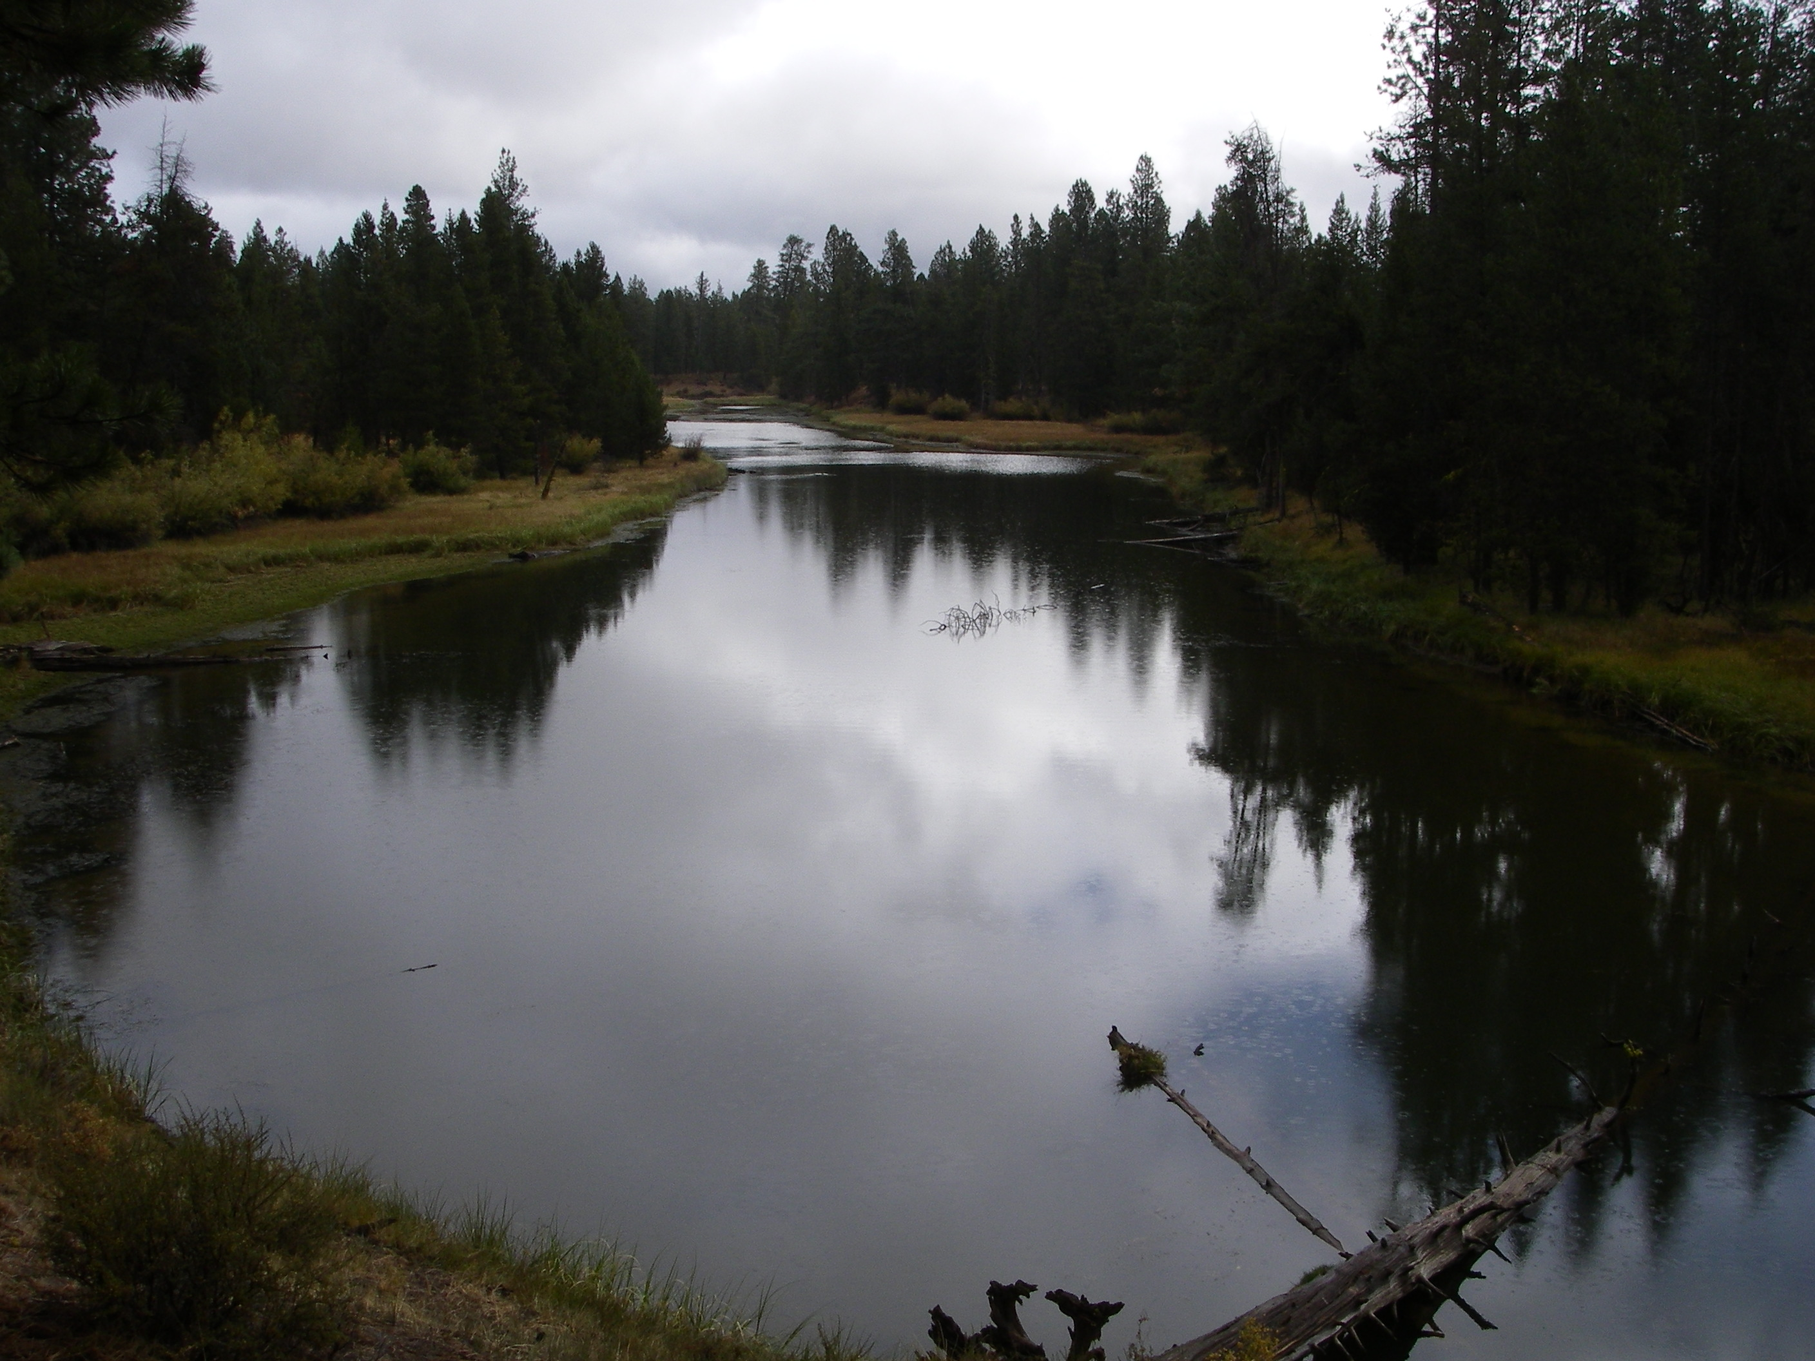
Deschutes Basin
Habitat Conservation Plan
Working Group Meeting
December 14, 2017
Redmond, Oregon

Slide 2
AGENDA
Welcome and Introductions
News and Updates
Proposed Conservation Measures
Alternative Conservation being Evaluated
Status and Schedule for NEPA Compliance
DBHCP Working Group Meeting December 14, 2017

Slide 3
NEWS AND UPDATES
DBHCP Working Group Meeting December 14, 2017

Slide 4
News and Updates
BOR Section 7 Consultation
DBHCP Working Group Meeting December 14, 2017

Slide 5
PROPOSED
CONSERVATION
MEASURES
DBHCP Working Group Meeting December 14, 2017

Slide 6
Crane Prairie Reservoir
Conservation Measure CP-1
DBHCP Working Group Meeting December 14, 2017

Slide 7
Crane Prairie Reservoir
From March 15 through July 15, the water surface elevation of Crane Prairie Reservoir will be maintained between 4,443.23 feet and 4,443.48 feet, which corresponds to storage volumes of approximately 46,800 acre-feet and 48,000 acre-feet, respectively.
Purpose: Minimize fluctuations in water depth during OSF breeding and summer rearing/foraging
DBHCP Working Group Meeting December 14, 2017

Slide 8
Crane Prairie Reservoir
From July 16 through July 31, the water surface elevation of Crane Prairie Reservoir may be lowered at a rate of no more than 0.05 foot per day.
Purpose: Allow release of stored water while minimizing rate of change in water depth during late stages of OSF metamorphosis
DBHCP Working Group Meeting December 14, 2017

Slide 9
Crane Prairie Reservoir
From August 1 through October 31, the water surface elevation of Crane Prairie Reservoir may be lowered at a rate of no more than 0.10 foot per day.
Purpose: Allow release of stored water at increased, but still slow rate during OSF transition to overwintering
DBHCP Working Group Meeting December 14, 2017

Slide 10
Crane Prairie Reservoir
From November 1 through March 14, the water surface elevation of Crane Prairie Reservoir will be maintained at or above elevation 4,441.23 feet (storage volume of approximately 37,870 acre-feet).
Purpose: Maintain OSF overwintering habitat in the reservoir
DBHCP Working Group Meeting December 14, 2017

Slide 11
Crane Prairie Reservoir
The minimum instream flow in the Deschutes River between Crane Prairie Dam and Wickiup Reservoir will be 75 cfs at all times unless total inflow to the reservoir is not sufficient to maintain this level of instream flow and meet the water surface elevations requirements in Items A through D. When total inflow is not sufficient to maintain a minimum instream flow of 75 cfs and meet the water surface elevation requirements in Items A through D, the instream flow may be reduced to 30 cfs. If total inflow to the reservoir is not sufficient to meet the water surface elevation requirements in Items A through D and maintain an instream flow of 30 cfs, the instream flow will remain at 30 cfs and the water surface elevation requirements in Items A through D will be relaxed until such time as inflow increases.
Purpose: Balance instream flow and reservoir habitat
DBHCP Working Group Meeting December 14, 2017

Slide 12
Wickiup Reservoir
Conservation Measure WR-1
DBHCP Working Group Meeting December 14, 2017

Slide 13
Wickiup Reservoir
From April 1 through September 15, flow in the Deschutes River below Wickiup Dam will be at least 600 cfs unless the combination of storage in Wickiup Reservoir and inflow to the reservoir is insufficient to maintain 600 cfs. When available storage and inflow are insufficient to maintain a flow of 600 cfs below Wickiup Dam, USFWS will determine the flow that will be maintained based on available storage, inflow, anticipated duration of reduced flow, and potentially affected life stage(s) of Oregon spotted frog.
Purpose: Support OSF breeding and summer rearing/foraging in the upper Deschutes River (Wickiup Dam to Bend)
DBHCP Working Group Meeting December 14, 2017

Slide 14
Wickiup Reservoir
From April 1 through April 30, flow in the Deschutes River below Wickiup Dam will not exceed 800 cfs unless USFWS has verified that Oregon spotted frog eggs at Dead Slough in La Pine State Park have hatched.
If the flow below Wickiup Dam is increased above 600 cfs during the month of April, it will not subsequently be allowed to decrease more than 30 cfs, whether in a single flow adjustment or cumulatively over the course of multiple flow adjustments, until after April 30.
Purpose: Minimize fluctuations in water depth in the upper Deschutes River during OSF breeding
DBHCP Working Group Meeting December 14, 2017

Slide 15
Wickiup Reservoir
For the first 5 years of DBHCP implementation, flow in the Deschutes River below Wickiup Dam will be at least 100 cfs from September 16 through March 31.
Beginning no later than Year 6 of DBHCP implementation, flow in the Deschutes River below Wickiup Dam will be at least 200 cfs from September 16 through March 31.
Purpose: Improve habitat for OSF overwintering in the upper Deschutes River
DBHCP Working Group Meeting December 14, 2017

Slide 16
Wickiup Reservoir
Beginning no later than Year 11 of DBHCP implementation, flow in the Deschutes River below Wickiup Dam will be at least 300 cfs from September 16 through March 31.
Beginning no later than Year 21 of DBHCP implementation, flow in the Deschutes River below Wickiup Dam will be at least 400 cfs from September 16 through March 31.
Purpose: Improve habitat for OSF overwintering in the upper Deschutes River from Wickiup Dam to Bend
DBHCP Working Group Meeting December 14, 2017

Slide 17
Wickiup Reservoir
Flow in the Deschutes River below Wickiup Dam may only be less than the minimums specified in Items D through G when simultaneous inflow to the reservoir is less than the respective minimum. At such times, outflow from the reservoir will match inflow minus seepage and evaporative loss.
Purpose: Avoid draining Wickiup Reservoir to the extent desirable summer flows in the upper Deschutes River cannot be maintained
DBHCP Working Group Meeting December 14, 2017

Slide 18
Wickiup Reservoir
Whenever the flow in the Deschutes River below Wickiup Dam is at or below 800 cfs, the maximum rate of increase in flow, as measured by change in water surface elevation at OWRD Gage 14056500, will be 0.1 foot per 4-hour period, and the maximum rate of decrease will be 0.2 foot per 12-hour period.
Purpose: Avoid rapid changes in water depth in the upper Deschutes River
DBHCP Working Group Meeting December 14, 2017

Slide 19
Middle Deschutes River
Conservation Measure DR-1
DBHCP Working Group Meeting December 14, 2017

Slide 20
Middle Deschutes River
DR-1 The DBBC Districts will coordinate stock water diversions and other diversions of live flow from the Deschutes River between November 1 and March 31 to prevent such diversions from resulting in a 1-day average flow of less than 250 cfs at OWRD Gage 14070500 below Bend.
Purpose: Prevent winter flows in the middle Deschutes River from dropping below 250 cfs
DBHCP Working Group Meeting December 14, 2017

Slide 21
Crescent Creek
Little Deschutes River
Conservation Measures
CC-1, CC-2 and CC-3
DBHCP Working Group Meeting December 14, 2017

Slide 22
Crescent Creek / Little Deschutes River
CC-1 Tumalo Irrigation District will operate Crescent Dam to maintain a flow of at least 20 cfs at all times below the dam, provided there is sufficient inflow to Crescent Lake Reservoir and/or storage in the reservoir to support this flow.
Purpose: Maintain wetland habitat for OSF in lower Crescent Creek and lower Little Deschutes River during the storage season
DBHCP Working Group Meeting December 14, 2017

Slide 23
Crescent Creek / Little Deschutes River
CC-2 Tumalo Irrigation District will not increase in the flow below Crescent Dam more than 30 (±2) cfs per 24-hour period or decrease the flow more than 20 (±2) cfs per 48-hour period, except under emergency conditions.
Purpose: Avoid rapid changes in water depth in lower Crescent Creek and lower Little Deschutes River
DBHCP Working Group Meeting December 14, 2017

Slide 24
Crescent Creek / Little Deschutes River
CC-3 Ramp-down of releases of irrigation storage from Crescent Lake Reservoir will begin no earlier than September 1 and end no later than October 31 of each year, unless earlier ramp-down is necessary to protect infrastructure, avoid draining the reservoir or respond to an emergency situation.
Purpose: Maintain summer rearing/foraging habitat along lower Crescent Creek and lower Little Deschutes River through OSF metamorphosis, and complete transition to winter flows prior to OSF overwintering
DBHCP Working Group Meeting December 14, 2017

Slide 25
Whychus Creek
Conservation Measures
WC-1, WC-2, WC-3, WC-4 and WC-5
DBHCP Working Group Meeting December 14, 2017

Slide 26
Whychus Creek
WC-1 No later than 5 years after the date of issuance of the Incidental Take Permits, Three Sisters Irrigation District (TSID) will add 3.0 cfs to the 28.18 cfs of irrigation rights TSID has already converted to permanent instream water rights on Whychus Creek since 2005 (for a total of 31.18 cfs of instream water rights). The new instream water rights will have the same priority dates as TSID’s respective irrigation rights.
Purpose: Increase summer flows in Whychus Creek to improve habitat conditions for salmonids
DBHCP Working Group Meeting December 14, 2017

Slide 27
Whychus Creek
WC-1 (cont.) All instream flow requirements of this measure will be effective immediately downstream of the TSID diversion, or at the nearest gaging location downstream of the TSID diversion. Beginning immediately upon issuance of the Incidental Take Permits, TSID will monitor flow in Whychus Creek at OWRD Gage 14076020 whenever TSID is diverting water, and will adjust its diversions as necessary to maintain specified minimum instream flows on a daily-average basis. Beginning no later than 5 years after the date of issuance of the Incidental Take Permits, TSID will reduce the interval for averaging and maintaining minimum instream flows from 24 hours to no more than 60 minutes.
Purpose: Ensure the effectiveness of WC-1
DBHCP Working Group Meeting December 14, 2017

Slide 28
Whychus Creek
WC-1 (cont.) For those irrigation rights with priority dates equal to the recently-created and new instream rights (as identified in the first paragraph above), water will be shared proportionally between irrigation and instream rights whenever there is insufficient natural flow above the TSID diversion to meet all of the rights. However, TSID will reduce diversions disproportionately if necessary to ensure the instream flow at Gage 14076020 does not drop below 20 cfs (averaged over no more than 60 minutes) while TSID is diverting. To help minimize the amount of time when the flow at Gage 14076020 is less than the full instream water right, TSID will continue to manage water “on-demand,” whereby TSID will only divert and deliver to its patrons when specifically requested by its patrons.
Purpose: Avoid extremely low summer flows in Whychus Creek
DBHCP Working Group Meeting December 14, 2017

Slide 29
Whychus Creek
WC-2 For the full term of the DBHCP, TSID will provide $6,000 each year, deposited into an interest-bearing account, to fund temporary instream leasing in years when natural flows in Whychus Creek are insufficient to maintain the permanent instream water rights. The use of these funds to secure temporary instream leases in these dry years will be handled by the Deschutes River Conservancy or a similar entity acceptable to USFWS and NMFS.
Purpose: Avoid extremely low summer flows in Whychus Creek
DBHCP Working Group Meeting December 14, 2017

Slide 30
Whychus Creek
WC-3 Over the term of the DBHCP, TSID will maintain and operate fish screens at its Whychus Creek diversion to ensure they function according to the NMFS downstream migrant fish screen criteria they were designed to meet.
Over the term of the DBHCP, TSID will maintain and operate its diversion structure to ensure it continues to function without interference to the upstream migration of anadromous fish.
Purpose: Ensure upstream and downstream fish passage in Whychus Creek
DBHCP Working Group Meeting December 14, 2017

Slide 31
Whychus Creek
WC-4 TSID will assist with the piping of patron-owned canals (patron laterals) within TSID. The goal of this measure will be to pipe all patron laterals in TSID (remaining 11 miles) within 15 years of issuance of the Incidental Take Permits, subject to patron willingness and funding. TSID will assist with project design, application for funding, and pipe installation.
Purpose: Increase the efficiency in use of water on TSID
DBHCP Working Group Meeting December 14, 2017

Slide 32
Whychus Creek
WC-5 When the flow in Whychus Creek downstream of the TSID Diversion (measured at OWRD Gage 14076020) is 50 cfs or less, the amount of water being diverted will not be increased or decreased more than 10 cfs/hour.
Purpose: Avoid rapid changes in water depth in Whychus Creek
DBHCP Working Group Meeting December 14, 2017

Slide 33
Crooked River
Ochoco Creek
McKay Creek
Conservation Measures
CR-1, CR-2, CR-3, CR-4, CR-5 and CR-6
DBHCP Working Group Meeting December 14, 2017

Slide 34
Crooked River – Measure CR-1
Each year, 13,000 acre-feet of the available uncontracted storage in Prineville Reservoir will be held until the end of the active irrigation season. If the total available uncontracted storage is less than 13,000 acre-feet on the annual day of allocation, all available uncontracted storage will be held until the end of the active irrigation season.
Each year, the entire City of Prineville mitigation storage (up to 5,100 acre-feet) in Prineville Reservoir will be held until December 1.
Purpose: Reserve all Prineville mitigation storage and a portion of the uncontracted storage to maintain winter flows in the Crooked River
DBHCP Working Group Meeting December 14, 2017

Slide 35
Crooked River – Measure CR-1
Beginning on the first day after the end of the active irrigation season, water that has been held from uncontracted storage (up to 13,000 acre-feet) will be released at a daily average rate of 50 cfs at OWRD Gage 14080500 below Bowman Dam (also known as PRVO Gage). From December 1 through January 31, the City of Prineville mitigation storage (up to 5,100 acre-feet) will also be released to contribute to the 50 cfs at PRVO Gage.
Purpose: Maintain a minimum flow of 50 cfs in the Crooked River during the winter
DBHCP Working Group Meeting December 14, 2017

Slide 36
Crooked River – Measure CR-1
If all uncontracted storage is depleted prior to December 1, OID will bypass live flow and/or release contracted storage to maintain a flow of 50 cfs at the PRVO Gage. From December 1 through January 31, OID will provide that portion of the 50 cfs that cannot be met from City of Prineville mitigation storage and uncontracted storage combined. From February 1 until the onset of the next active irrigation storage, OID will again provide the quantity of water needed to maintain the flow of 50 cfs after all City of Prineville mitigation storage and uncontracted storage is depleted. Water that has been temporarily leased instream from OID patrons may also be used to support the flow of 50 cfs, except during the period from December 1 through January 31.
Purpose: Use OID live flow and storage to ensure 50 cfs in the Crooked River during the winter
DBHCP Working Group Meeting December 14, 2017

Slide 37
Crooked River – Measure CR-1
During the active irrigation season, OID and NUID will have no obligations to bypass live flow or release storage to maintain specific instream flows at PRVO Gage or CAPO Gage.
Purpose: Use uncontracted storage to meet summer flow targets in the Crooked River
DBHCP Working Group Meeting December 14, 2017

Slide 38
Ochoco Creek – Measure CR-2
OID Contributions to Ochoco Creek Flow: OID will contribute to the flow in Ochoco Creek as specified in Table CR-2 by releasing water from the Ochoco Main Canal downstream of Ochoco Reservoir. These contributions will be additive to any permanent instream water right transfers and/or temporary instream leases secured through the Crooked River Conservation Fund (Measure CR-5) on Ochoco Creek. The OID contributions will not be made if they would require pumping from inactive storage in Ochoco Reservoir (below water surface elevation 3,074.94 feet) unless OID is pumping water from inactive storage for irrigation purposes. If mechanical failure or malfunction at Ochoco Dam prevents the release of the full amount specified in Table CR-2, the OID contribution will be the maximum amount the Bureau of Reclamation determines can safely be released, and the full contribution will be resumed as soon as the mechanical problem or malfunction is corrected.
DBHCP Working Group Meeting December 14, 2017

Slide 39
Table CR-2. Ochoco Irrigation District Contributions to Ochoco Creek Flow
Stream Reach | Average OID Contribution |  | Measurement Location | Averaging Interval
 | During Active Irrigation Season | Outside Active Irrigation Season
Ochoco Dam (RM 11.2) to D-2 Drain Confluence (RM 6.3) | 5.0 cfs | 3.0 cfs | OWRD Gage 14085300 below Ochoco Dam | Hourly
D-2 Drain Confluence (RM 6.3) to mouth | 5.0 cfs | 5.0 cfs | RM 4.7 at Ryegrass Diversion | Daily
DBHCP Working Group Meeting December 14, 2017

Slide 40
Ochoco Creek – Measure CR-2 (continued)
Pass-through of Upstream Conserved Water: OID will allow water from temporary or permanent instream water right transfers upstream of Ochoco Reservoir to pass through the reservoir and to the mouth of Ochoco Creek without storage or diversion, regardless of whether the associated water rights are senior or junior to OID’s storage and diversion rights.
Purpose: Increase the minimum flow in lower Ochoco Creek year round
DBHCP Working Group Meeting December 14, 2017

Slide 41
McKay Creek – Measure CR-3
Minimum Flow in McKay Creek: Water will be bypassed and/or released into McKay Creek, as needed, to provide the minimum instream flows specified in Table C-R3 during the active irrigation season . Outside the active irrigation season, McKay Creek will be allowed to flow without diversion by OID or its patrons.
McKay Creek Water Switch: OID will fulfill its obligations under the Memorandum of Understanding (MOU) between OID and the Deschutes River Conservancy (DRC) effective as of May 30, 2017, subject to the terms and conditions of the MOU. OID will not exercise its termination rights under the MOU, provided that the DRC fulfills its obligations under the MOU and OID determines, in its discretion, that the contingencies described in Paragraph F of the MOU are satisfied.
Purpose: Increase the minimum flow in McKay Creek during the irrigation season
DBHCP Working Group Meeting December 14, 2017

Slide 42
Table CR-3. Minimum Instream Flows for McKay Creek During the Irrigation Season
Stream Reach | Minimum Daily Average Instream Flow During the Active Irrigation Season |  | Measurement Location
 | Prior to McKay Creek Water Switch | After Full McKay Creek Water Switch
Jones Dam (RM 5.8) to Dry Creek (RM 3.9) | Equal to flow immediately upstream of Jones Dam, to a maximum of 2.0 cfs | Equal to flow immediately upstream of Jones Dam, to a maximum of 11.2 cfs | At Jones Dam
Dry Creek (RM 3.9) to Reynolds Siphon (RM 3.2) | 3.0 cfs | Equal to flow immediately upstream of Jones Dam, to a maximum of 12.2 cfs | At Reynolds Siphon
Reynolds Siphon (RM 3.2) to mouth | 5.0 cfs | Equal to flow immediately upstream of Jones Dam, to a maximum of 14.2 cfs | At Cook Inverted Weir (RM 1.3)
DBHCP Working Group Meeting December 14, 2017

Slide 43
Streamflow Monitoring – Measure CR-4
OID will monitor flow with gages or other suitable means at the locations specified in Table CR-4 to verify compliance with the instream flow requirements of the DBHCP.
Purpose: Verify DBHCP compliance
DBHCP Working Group Meeting December 14, 2017

Slide 44
Table CR-4. Streamflow Monitoring Locations in the Crooked River Subbasin
Water Body | Location | Purpose | Type of Gage
Crooked River (RM 70.0) | Below Bowman Dam (OWRD Gage 14080500) | Verify flow downstream of Bowman Dam outside the active irrigation season | Existing Hydromet station PRVO
Crooked River (RM 56.5) | Downstream of Crooked River Diversion | Verify flow past Crooked River Diversion | Manual staff gage for reference when adjusting rate of diversion
Crooked River (RM 48.0) | Near Hwy 126 Bridge (OWRD Gage 14081500) | Monitor flow at location of anticipated minimum between Bowman Dam and Lake Billy Chinook | Existing Hydromet station CAPO
Ochoco Creek (RM 11.2) | Downstream of Ochoco Dam (OWRD Gage 14085300) | Verify flow between Ochoco Dam and Red Granary Diversion | Existing Hydromet station OCHO
Ochoco Creek (RM 10.2) | Red Granary Diversion | Verify flow between Red Granary and Breese Dam | Manual staff gage for reference when adjusting rate of diversion
Ochoco Creek (RM 9.4) | Downstream of Golf Course Dam | Verify flow at location of anticipated minimum between Ochoco Dam and mouth | New recording gage with telemetry
Ochoco Creek (RM 7.5) | Breese Dam | Verify flow between Breese Dam and Ryegrass Diversion | Manual staff gage for reference when adjusting rate of diversion
Ochoco Creek (RM 5.1) | Crooked River Diversion Spill | Add Crooked River Diversion Canal spill to flow at Breese Dam to estimate flow above Ryegrass during irrigation season | Existing recording gage with telemetry
Ochoco Creek (RM 4.7) | Ryegrass Diversion | Verify flow between Ryegrass Diversion and mouth | Manual staff gage for reference when adjusting rate of diversion
McKay Creek (RM 5.8) | At Jones Dam | Verify flow between Jones Dam and Dry Creek | Manual staff gage for reference when adjusting rate of diversion
McKay Creek (RM 3.2) | At Reynolds Siphon (Crooked River Distribution Canal) | Verify flow between Dry Creek and Reynolds Siphon | Manual staff gage for reference when adjusting rate of diversion
McKay Creek (RM 1.3) | At Cook Inverted Weir | Verify flow between Reynolds Siphon and Cook Inverted Weir | New recording gage with telemetry
McKay Creek (RM 0.6) | At Smith Inverted Weir | Verify flow between Cook Inverted Weir and mouth | Manual staff gage for reference when adjusting rate of diversion
DBHCP Working Group Meeting December 14, 2017

Slide 45
Crooked River Conservation Fund – Measure CR-5
Within six months after issuance of the Incidental Take Permits, and no later than March 1 of each year thereafter for the term of the Permits, OID, NUID and the City of Prineville will contribute a combined total of $8,000 annually to the Crooked River Conservation Fund. This amount will be adjusted annually for inflation in direct proportion to the change in annual average Consumer Price Index for all urban consumers (CPI-U), West Region, all items, Base Period 1982-84=100, published by the Bureau of Labor Statistics. The fund may be used for activities that support DBHCP conservation measures and/or benefit the covered species within the Crooked River Subbasin. Any use of the fund must be approved by USFWS and NMFS after consultation and coordination with OID, NUID and the City of Prineville.
DBHCP Working Group Meeting December 14, 2017

Slide 46
Crooked River Conservation Fund –
Measure CR-5 (continued)
Water purchased from OID patrons with the Conservation Fund for temporary instream leasing may be stored in Ochoco Reservoir or Prineville Reservoir, as appropriate, and released at any time during the OID legal irrigation season (February 1 through November 30) determined by USFWS and NMFS.
Purpose: Support additional improvements to habitat for covered fish species
DBHCP Working Group Meeting December 14, 2017

Slide 47
Screening of Diversion Structures –
Measure CR-6
District Diversions: OID and NUID will maintain and operate fish screens to prevent the entrainment of juvenile salmonids on all District-controlled diversions accessible to covered fish species. Existing screens will be maintained and operated to ensure they function to their original design standards for safe fish exclusion. New or replacement screens will meet NMFS criteria for downstream migrant fish screens current at the time of construction.
DBHCP Working Group Meeting December 14, 2017

Slide 48
Screening of Diversion Structures –
Measure CR-6 (continued)
Patron Diversions:
OID will provide $5,000 per year in cash or in-kind contributions of labor and technical expertise for the first five years of DBHCP implementation, for a total of $25,000, to fund the screening of patron pumps on the Crooked River, Ochoco Creek and McKay Creek.
OID will proactively contact patrons, screen manufacturers and potential sources of matching funds to encourage screening as quickly as possible.
DBHCP Working Group Meeting December 14, 2017

Slide 49
Screening of Diversion Structures –
Measure CR-6 (continued)
Patron Diversions:
Prior to OID funding of an individual screen the patron must:
  willingly enter into a written agreement with OID to allow the screening, and
  agree in writing to maintain the screen in proper working order and to allow OID, USFWS, NMFS and ODFW access for routine inspection of the screen outside the active irrigation season with 48-hour notice.
Purpose: Eliminate potential for entrainment of covered fish
DBHCP Working Group Meeting December 14, 2017

Slide 50
ALTERNATIVE
CONSERVATION
BEING EVALUATED
DBHCP Working Group Meeting December 14, 2017

Slide 51
Crane Prairie Reservoir
No major alternatives identified
Adaptive management will address uncertainty
DBHCP Working Group Meeting December 14, 2017

Slide 52
Wickiup Reservoir
Two alternatives identified
Both involve increased winter flows in the upper Deschutes River
DBHCP Working Group Meeting December 14, 2017

Slide 53
Alternatives to the DBHCP for the Operation of Wickiup Reservoir
DBHCP Period | Minimum Winter Flow (Sep 16 – Mar 31) Below Wickiup Dam (cfs)
 | Proposed DBHCP Measure WR-1 | Wickiup Alternative 1 | Wickiup Alternative 2
Years 1 – 5 | 100 | 100 | 100
Years 6 – 10 | 200 | 200 | 200
Years 11 – 20 | 300 | 300 | 300
Years 21 – 30 | 400 | 400 | 400
Years 31 – 40 | N/A | 500 | 500
Years 41 – 50 | N/A | N/A | 600
DBHCP Working Group Meeting December 14, 2017

Slide 54
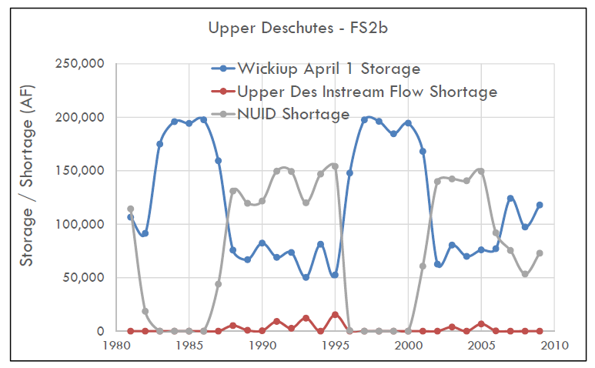
DBHCP Working Group Meeting December 14, 2017

Slide 55
Middle Deschutes River
No alternatives identified
Winter flow in the upper Deschutes River is priority use for conserved water under all alternatives
DBHCP Working Group Meeting December 14, 2017

Slide 56
Crescent Creek
Little Deschutes River
One alternative related to winter flows
Refinement of summer flows to be addressed through adaptive management
DBHCP Working Group Meeting December 14, 2017

Slide 57
Alternatives to the DBHCP for the Operation of Crescent Lake Reservoir
Dates | Minimum Flow Below Crescent Lake Dam (cfs)
 | Proposed DBHCP Measure CC-1 | Crescent Lake Alternative
March 15 – November 30 | 20 | 30
December 1 – March 14 | 20 | 20
DBHCP Working Group Meeting December 14, 2017

Slide 58
Whychus Creek
No alternatives identified
DBHCP already accomplishes complete piping of TSID canals
DBHCP Working Group Meeting December 14, 2017

Slide 59
Crooked River
One alternative identified thus far
Other alternatives are being developed
DBHCP Working Group Meeting December 14, 2017

Slide 60
Crooked River
Identified alternative
Secondary water right for uncontracted water
DBHCP Working Group Meeting December 14, 2017

Slide 61
Crooked River
Potential alternatives
Different minimum flows and/or different allocations of contracted and uncontracted water
Results of BSWG modeling will be used to refine DBHCP alternatives
DBHCP Working Group Meeting December 14, 2017

Slide 62
STATUS AND
SCHEDULE
FOR NEPA
COMPLIANCE
DBHCP Working Group Meeting December 14, 2017

