Slide 1
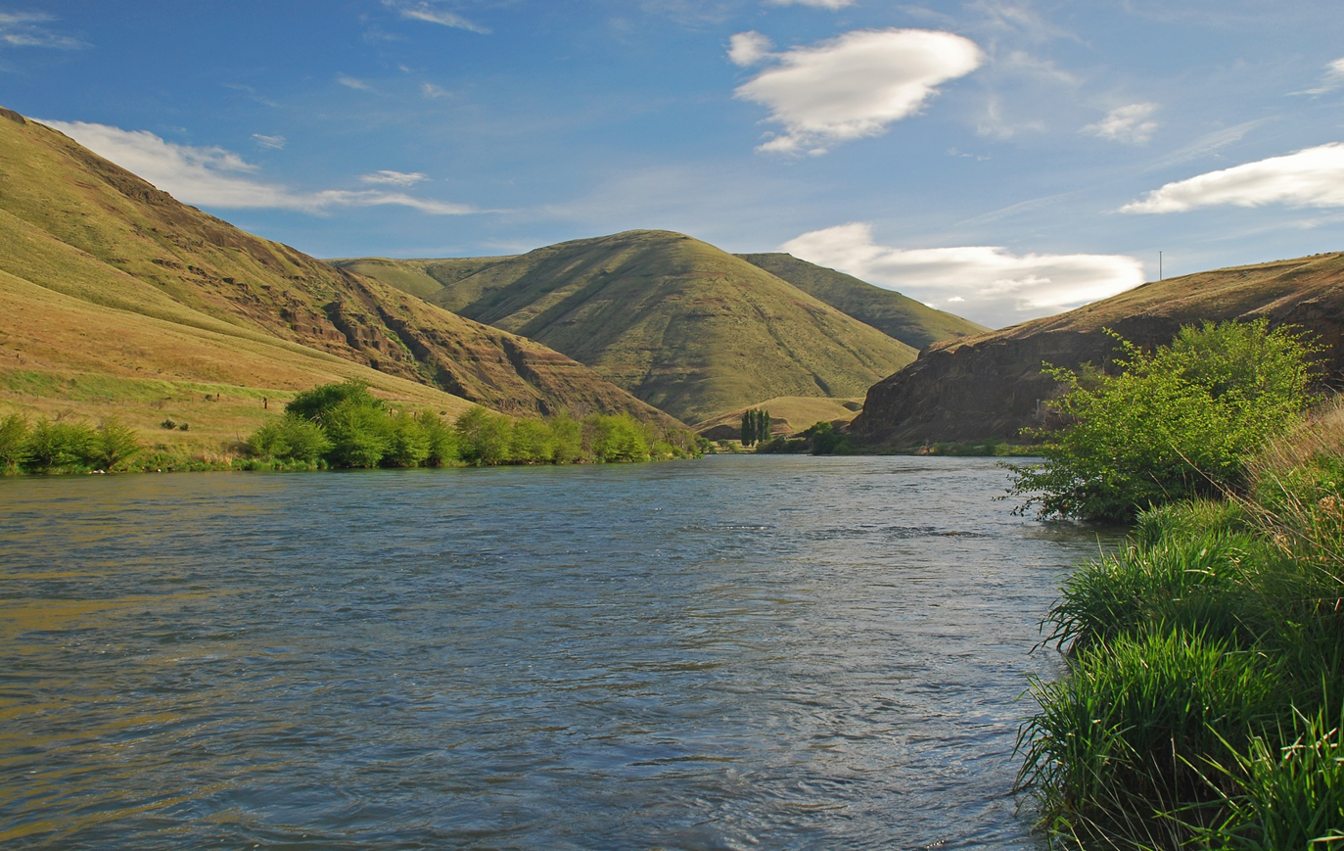

Lower Deschutes River Fish Population Status Update
Jason Seals
Mid-Columbia Fish District
Oregon Department of Fish and Wildlife

Slide 2
Updates
Steelhead
Spring and Fall Chinook
Trout Density Estimates
Smallmouth Bass Monitoring

Slide 3
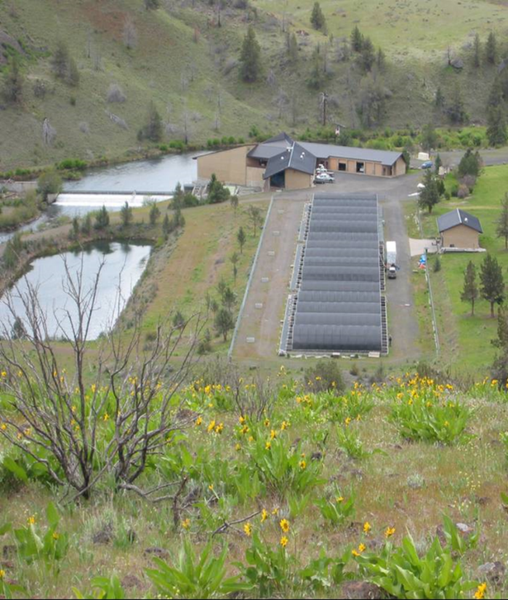
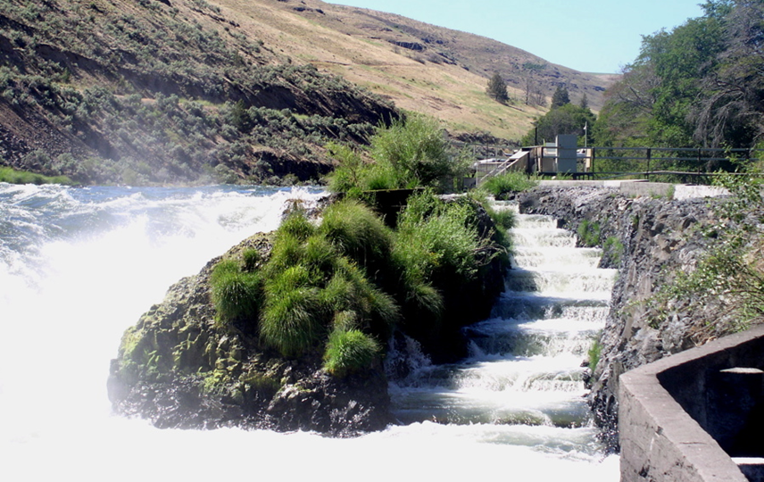
Sampling Sites/Methods
Sherars Trap
Pelton Trap
WSNFH
Mark-Recapture
Trap Counts
Carcass

Slide 4
WILD STEELHEAD ABOVE SHERARS
Notes:
Wild steelhead estimates above Sherars Falls have remained stable, comparable to most years on record.

Slide 5
STRAY HATCHERY STS ABOVE SHERARS
Notes:
The simple reason why anglers are catching fewer hatchery steelhead in the Deschutes is that there are fewer hatchery fish present than the previous about 15 years. The number of out of basin hatchery strays in the Deschutes are the lowest they have been since the mid 1990’s. We estimated a range from about 5,000 to 25,000 out of basin strays upstream of Sherars Falls from the late 1990’s to 2010 and have seen a decline to about 2,000 strays in 2015. Round Butte (Deschutes Stock) hatchery fish generally range from about 3,000 to 5,000 per year.
Our creel data shows that out of basin strays have traditionally accounted for about 70% of the hatchery fish harvested on average in the lower 43 miles of the Deschutes fishery.

Slide 6
Round Butte Steelhead Above Sherars Falls

Slide 7
Wild Fall Chinook
Notes:
We have estimated total escapement of adult wild fall chinook in the Deschutes River since 1977. The past five run years have been some the highest on record.

Slide 8
ADULT CHS HATCHERY RETURNS
Notes:
Very low returns to both facilities, WS 282, RBH 999, this years returns also tracking very low. Hatchery returns throughout basin very low.

Slide 9
Wild Spring Chinook at WSNFH
Notes:
Spring Chinook returns throughout the Columbia Basin are depressed, and Deschutes has generally continued a downward trend. Significant pre-spawning mortality in the Warm Springs, considerable work started to identify cause. Last year’s run slightly improved to 247. This years wild return tracking slightly improved, but very similar to last year.

Slide 10
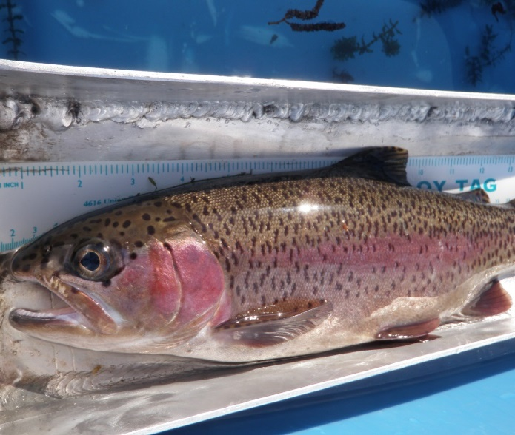
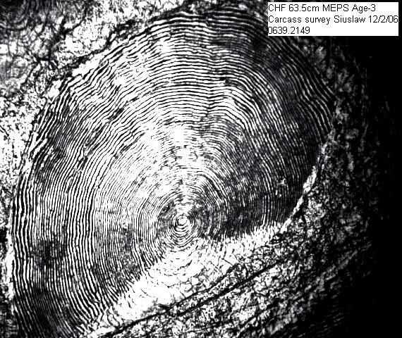
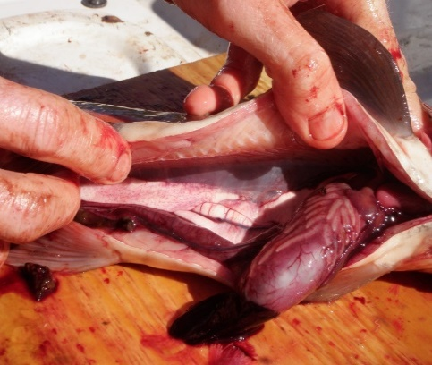
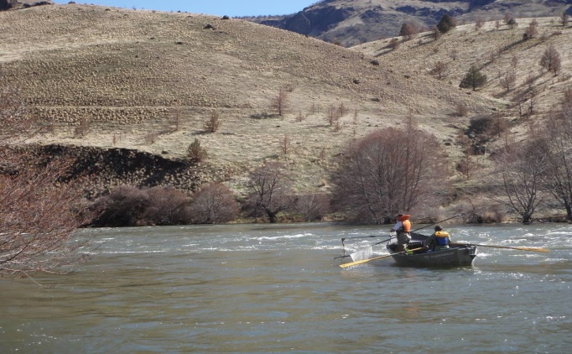
Deschutes Trout Monitoring
Previously Reported:
Growth
Age structure
Food consumption
Condition
Disease

Slide 11
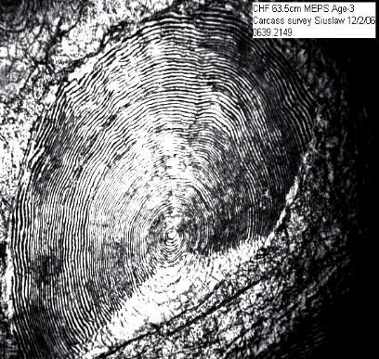
Deschutes Trout Monitoring
2019 to 2021:
Continued previous studies since 2014
Conducted M-R Estimates
  Nena Creek 2019, 2020
  North Junctions and Jones Canyon 2021

Slide 12
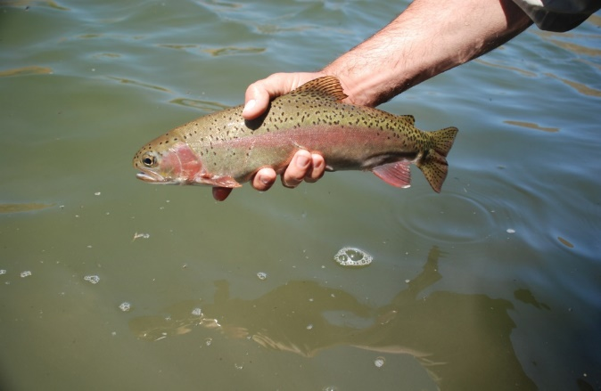
M-R Methods
Methods and Sections same as Historical (Schroeder and Smith 1989, Newton and Nelson 2000, Jones and Seals 2019)
Multiple pass electrofishing
Closed Population Models

Slide 13
Nena Creek Section Fish Per Mile

Slide 14
Jones Canyon Section Fish Per Mile

Slide 15
North Junction Section Fish Per Mile

Slide 16
North Junction Section Fish Per Mile

Slide 17
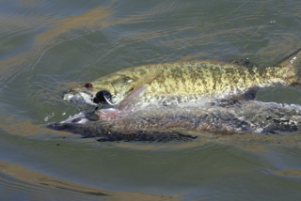
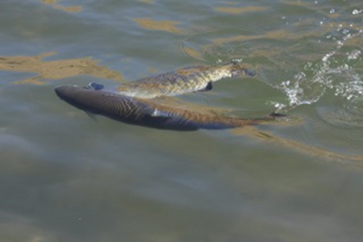
Smallmouth Bass

Slide 18
Bass Background
Before 2010- Bass Regularly Reported
2010-2021 Snorkel and electrofishing surveys
2010-2015 surveys captured no bass
Anglers report increasing smallmouth catch in 2016 and 2017.
Electrofishing Surveys confirmed increase

Slide 19
Findings
Distributed from Ferry Canyon (RM 26) to Mouth
PIT tagged individual displaying long migration patterns
Leaving the Deschutes in Late August and September
Re-entering the Deschutes April-June
No evidence of Natural Reproduction

Slide 20
Status Summary
Steelhead Returns Remain Low but Stable
Spring Chinook Returns are Low and Concerning
Fall Chinook Returns are Robust
Redband Trout Densities are Good
Smallmouth Bass continue to Summer Occupy lower 12 miles

Slide 21
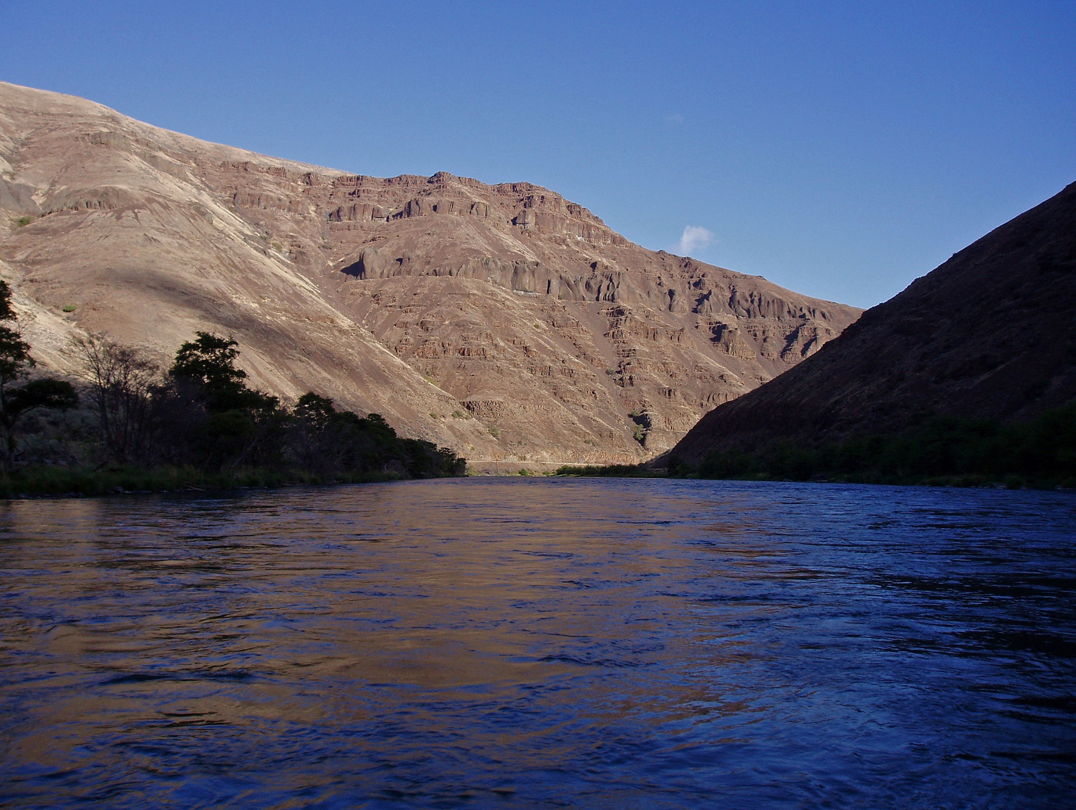
Questions

